Slide 1
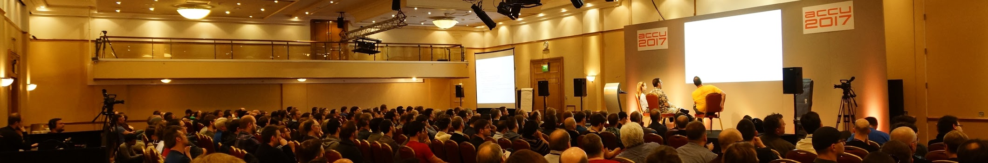
ACCU 2017
Bristol, April 25th-29th
Trip Report Felix Petriconi

Slide 2
My Trip Report
3rd visit of the ACCU conference
2nd conference with a contribution by myself
1st conference as a conference committee member

Slide 3
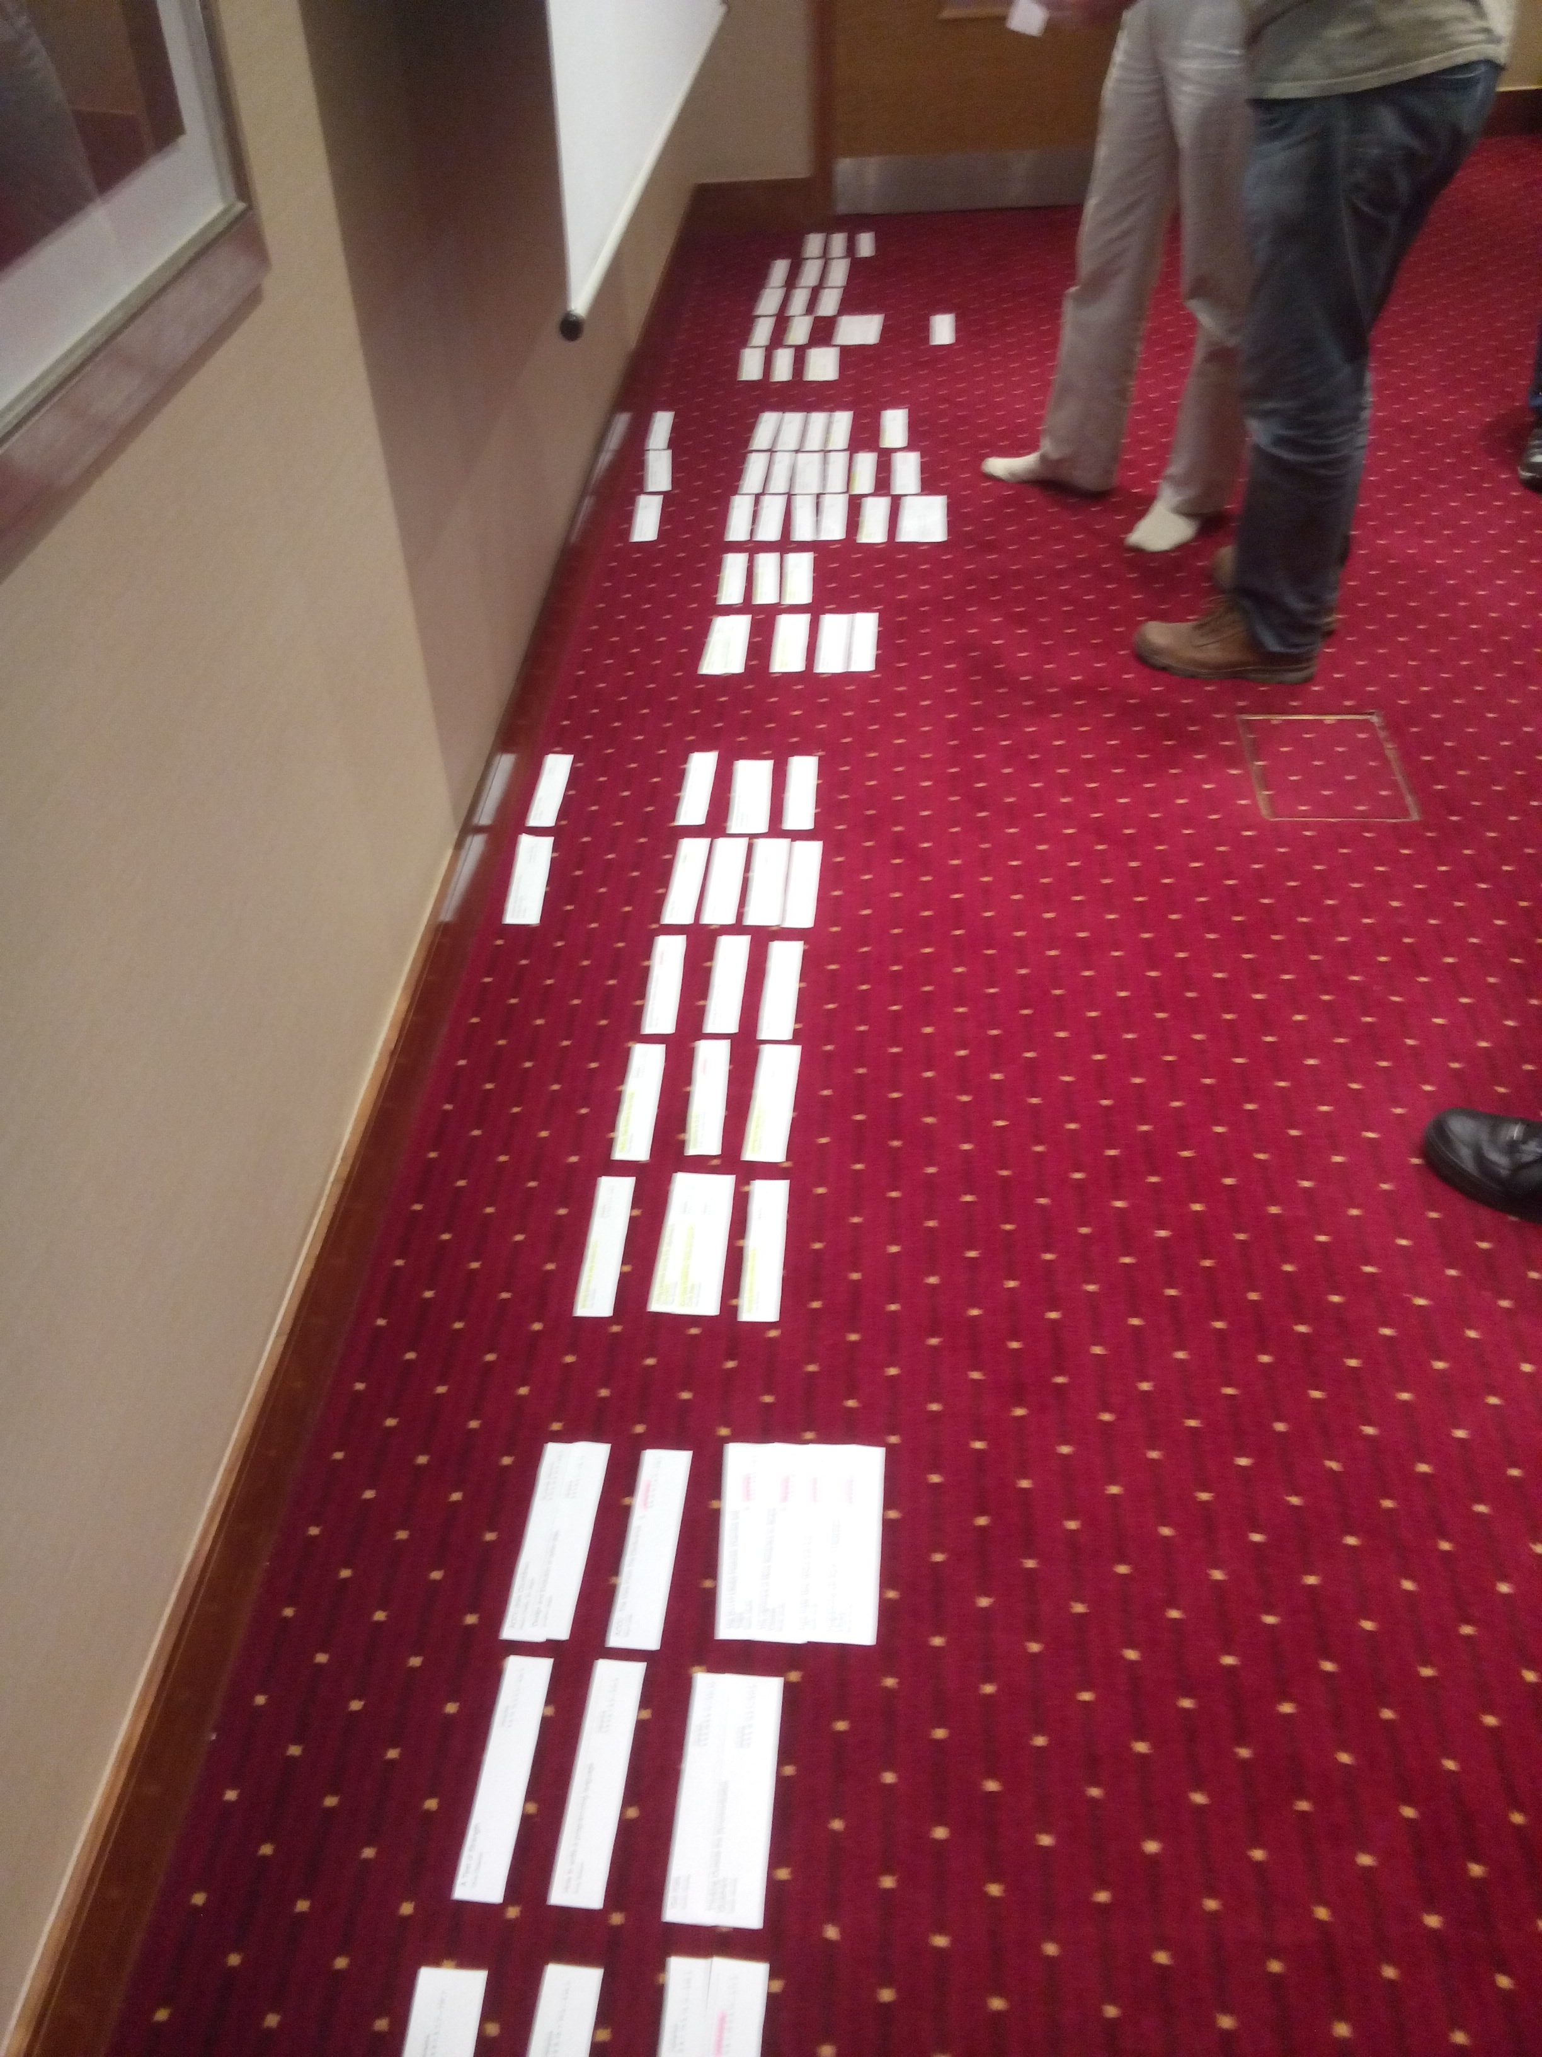
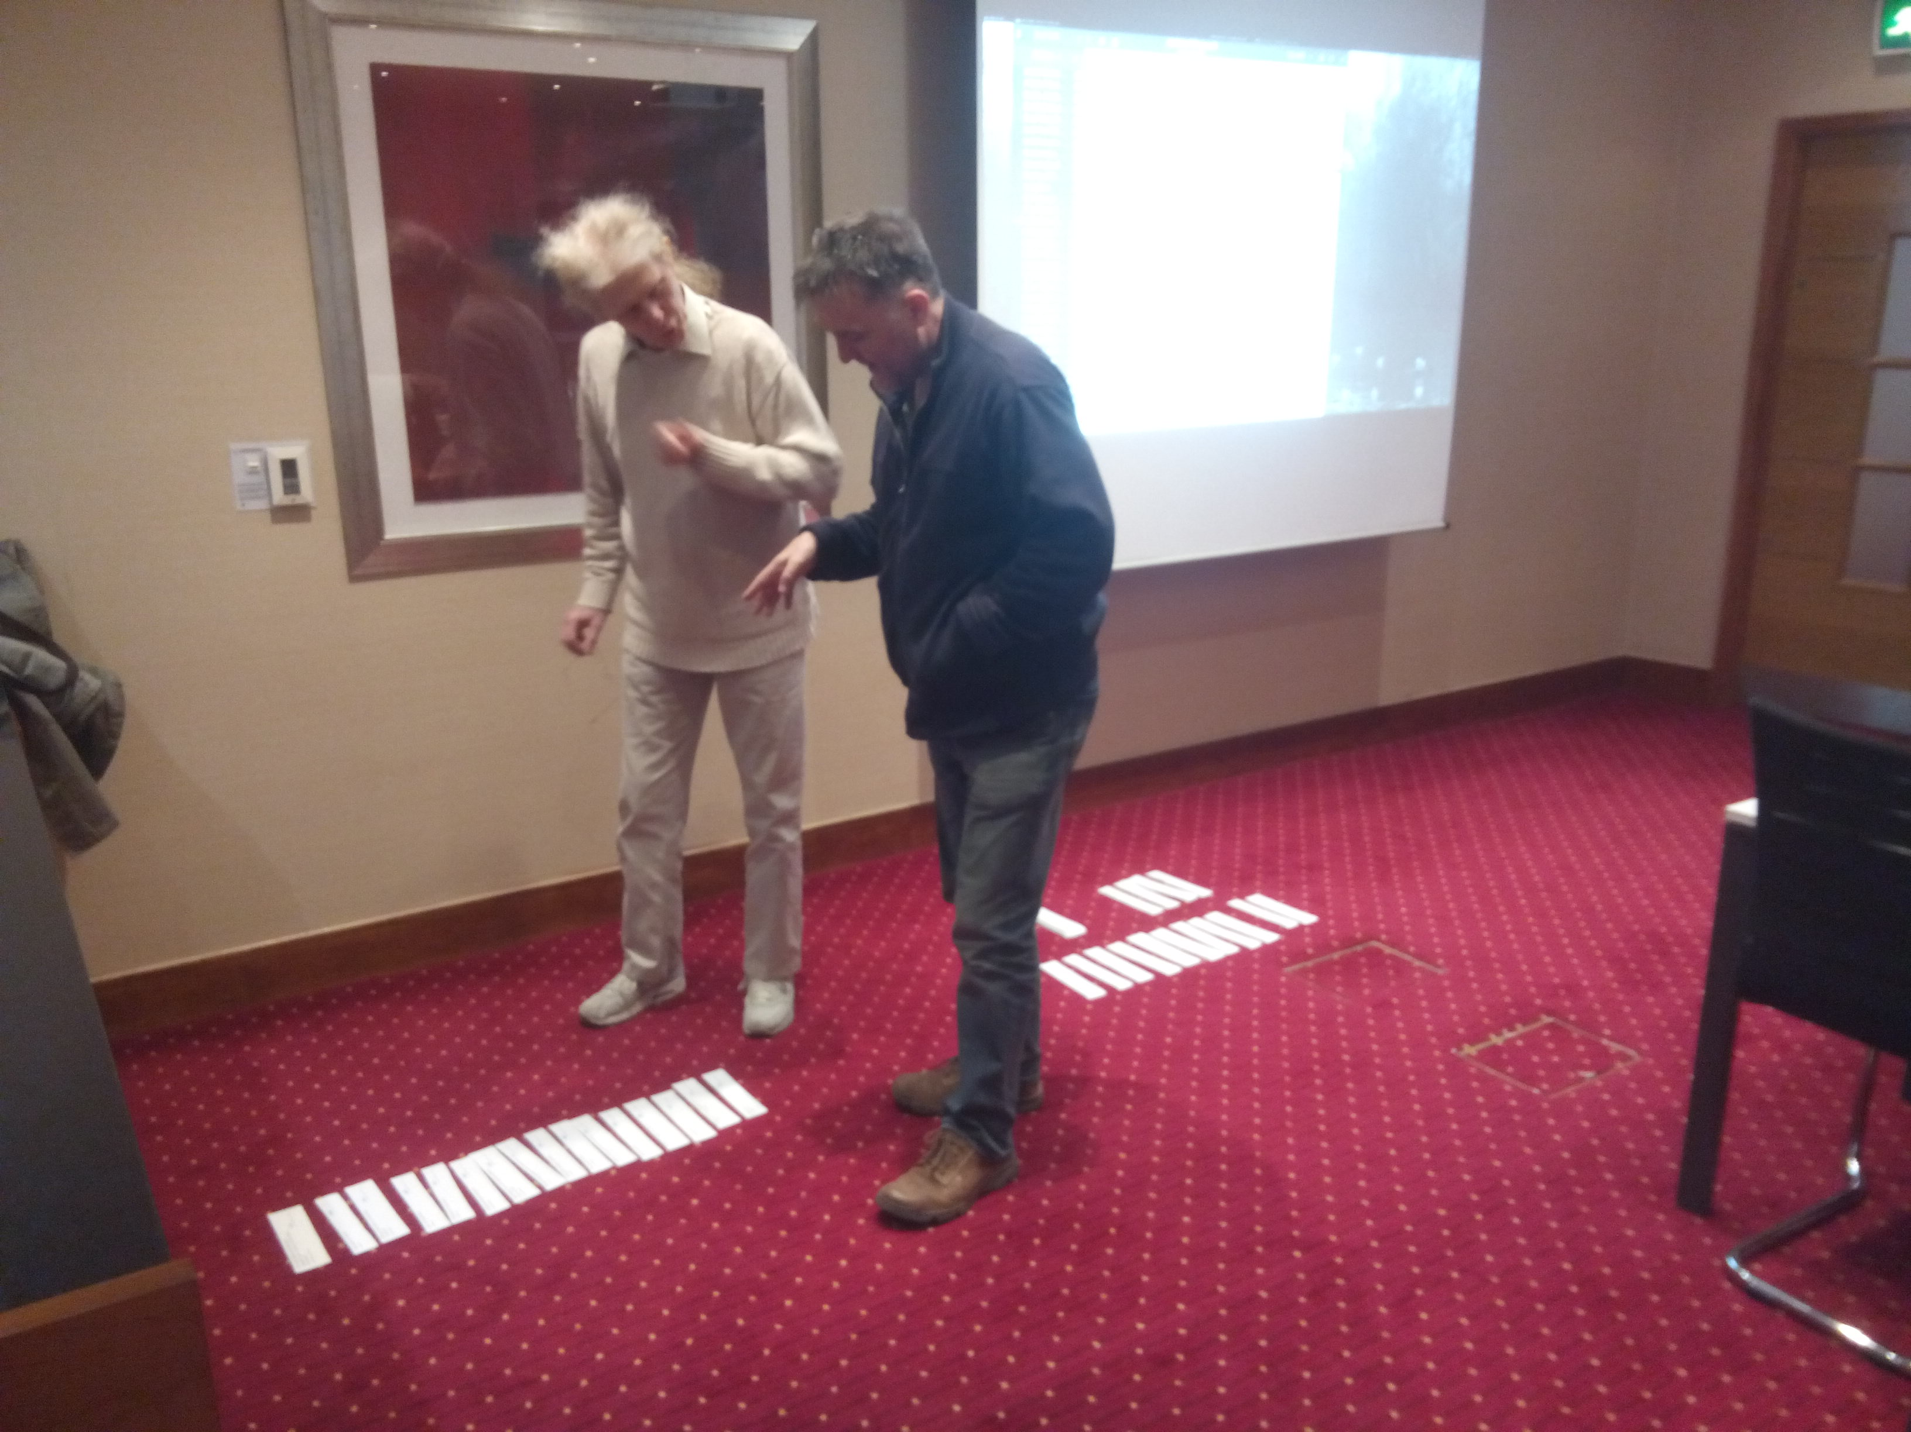
Finding the Program
~120 sessions and tutorials were proposed
4 pre-conference tutorials and 60 sessions had to be chosen
Meeting in London on December the 3rd

Slide 4
ACCU - Association of C and C++ Users
ACCU organization completely based on volunteers help
21th ACCU conference
The complete spillover goes to Code Club, an charity organization that offers all children the possibility to learn to code

Slide 5
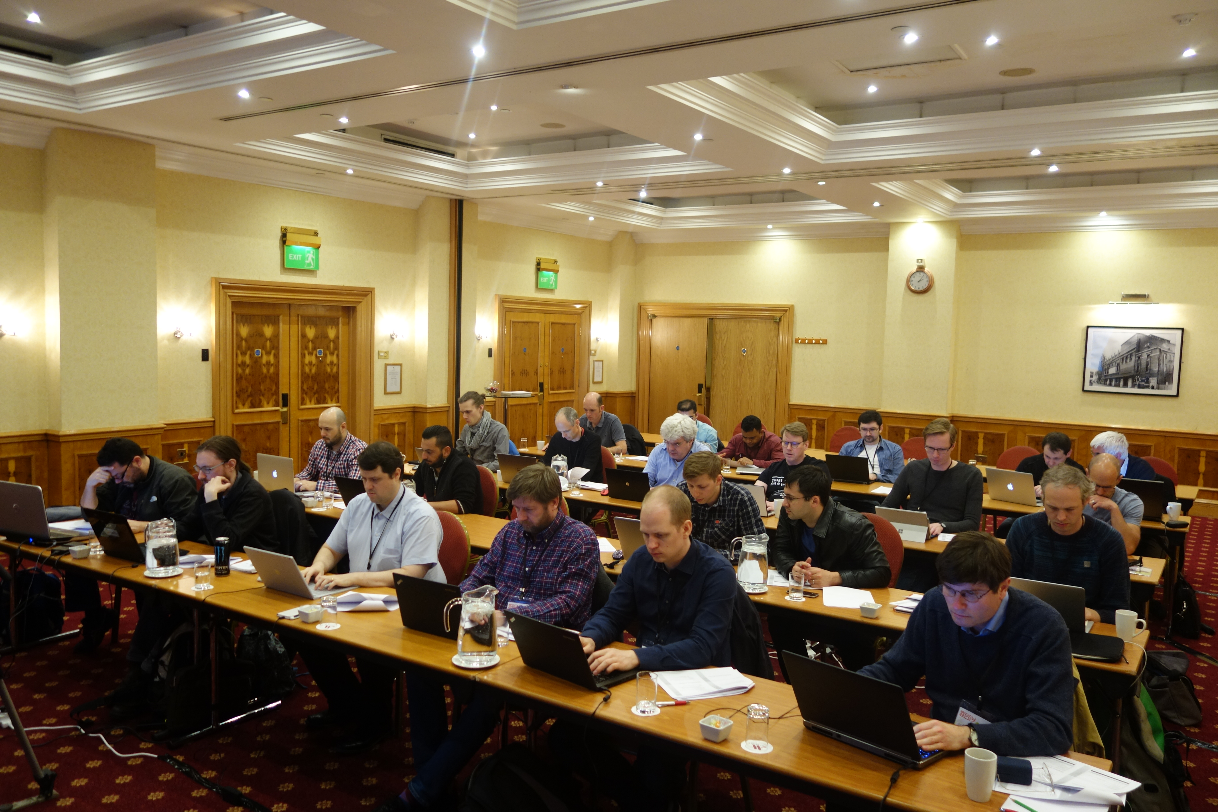
My Pre-Conference Tutorial
The Art of Writing Reasonable Concurrent Code
Recap why writing concurrent programs is necessary today
Introduction into high level concurrency abstractions
Introduction into C++11 standard futures

Slide 6
My Pre-Conference Tutorial Cont.
Introduction into C++17 (TS) / boost future extensions
Showing the deficiencies of the current C++ standard’s design
In depth tutorial with exercises into an alternative future implementation by Sean Parent from Adobe and myself: http://www.stlab.cc
In depth tutorial with exercises into CSP channels.

Slide 7
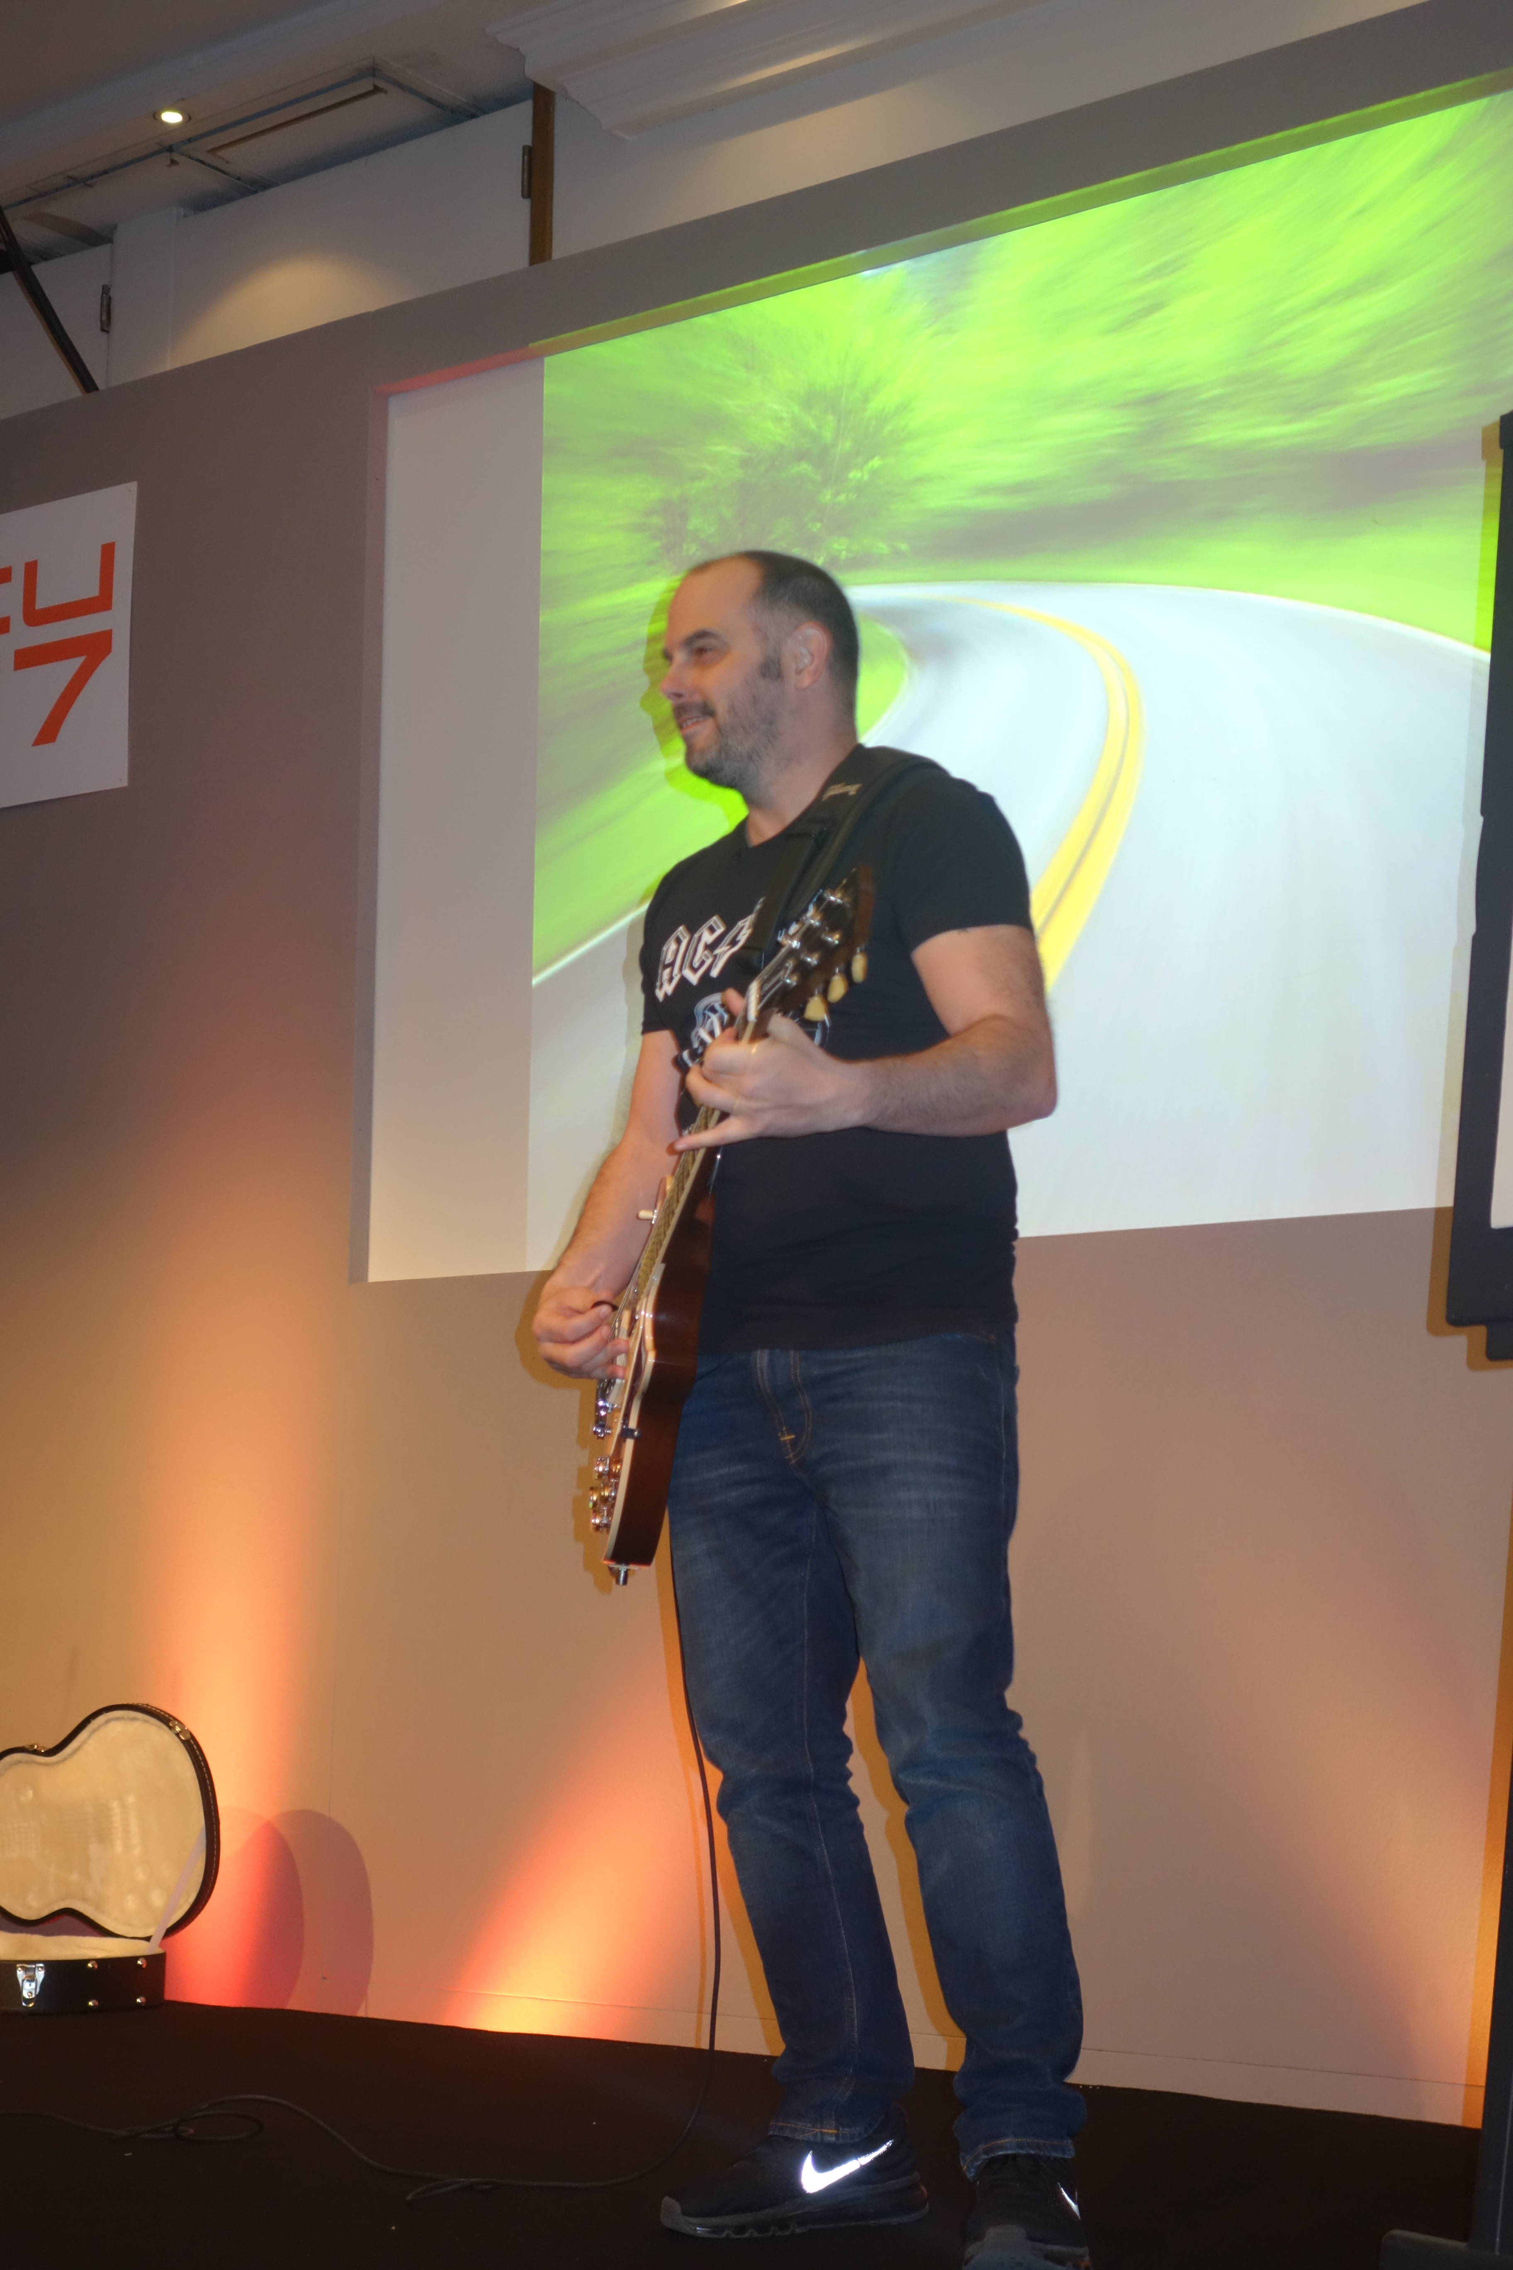
Conference Highlights 1st day
Keynote by Russ Miles
About the „Highway to Hell“ of micro-service architecture
Nico Josuttis: The nightmare of Move Semantics for Simple Classes
Louis Dionne: Metaprogramming in C++14
Introduction into boost::hana, a combination of boost::mpl and boost::fusion

Slide 8
Marshall Clow The Detection Idiom - a simpler way to SFINAE in C++17*
Pre-Detection Idiom Way
template <typename T>
class has_PrintTo {
typedef char Yes;
typedef struct No { char dummy[2]; };
static std::ostream os;
template<typename U>
static auto test(U* p) ->
decltype(PrintTo(*p, &os), Yes(0));
template<typename>
static No test(...);
public:
static const
bool value =
sizeof(test<T>(nullptr)) == sizeof(Yes);
};
New Detection Idiom Way
template<typename T>
using print_to_t = decltype(
PrintTo(std::declval<T&>(), std::declval<*std::ostream>()
);
template<typename T>
constexpr bool has_print_to_v = is_detected_v<print_to_t, T>;
* The code from proposal N4502 code can already be used with C++14, Visual Studio 2015

Slide 9
Conference Highlights 2nd day
Keynote by Brad Chamberlain from Cray Inc.
Current state of the open source language Chapel for HPC
John Lakos: Local (arena) Memory Allocators
Introduction into the new allocator concepts that come with C++17
Overview of performance gain in different contexts
Sergey Ignatchenko: Deterministic Components for Interactive Distributed Systems: Benefits and Implementation
Definition of (non-) deterministic systems
Overview of how to separate in a system deterministic from non deterministic components
Demonstration of debugging techniques in a massive multi-player game
Michel Grootjans: Why limiting your work in progress will speed up your project

Slide 10


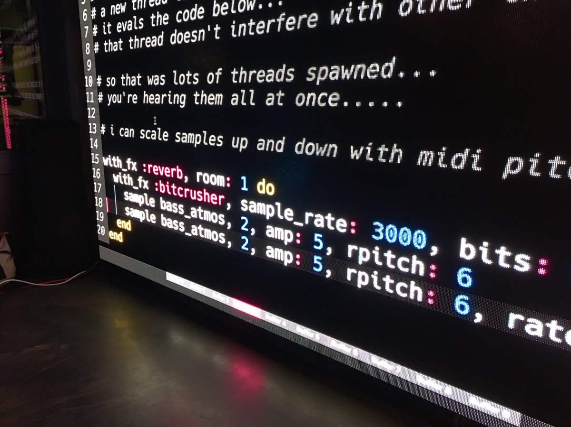
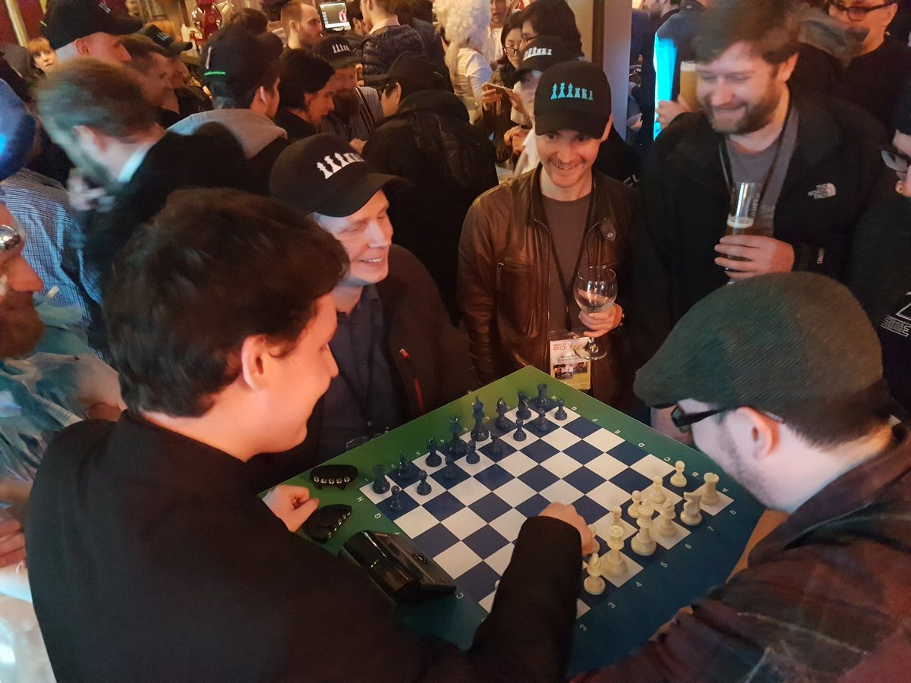
Bloomberg Event
Images by Austin Bingham, Vittorio Romeo and Paul Williams

Slide 11
Conference Highlights 3rd day
Keynote by Fran Buontempo
AI: Actual Intelligence
Sergei Sadovnikov: Automatic C++ source code generation with clang
Introduction into clang compiler front end
Demonstration of how simple it is to generate source code for enum to string conversion or data serialization and deserialization code
Dominic Robinson: Coroutines and C++ DSLs for Human Scale Concurrency
Basic introduction into co-routines C++17(TS) / Visual Studio 2015
Introduction into his new frame to easily compose in a type safe manner state machines

Slide 12
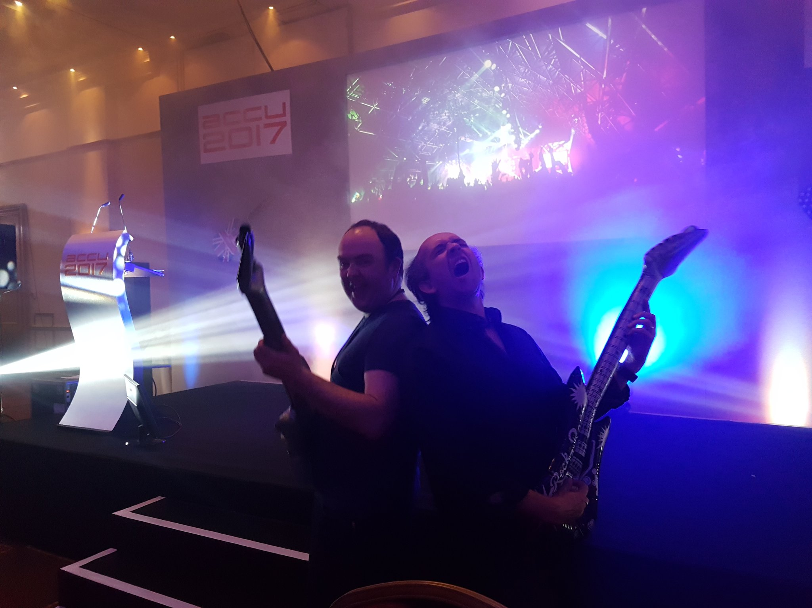
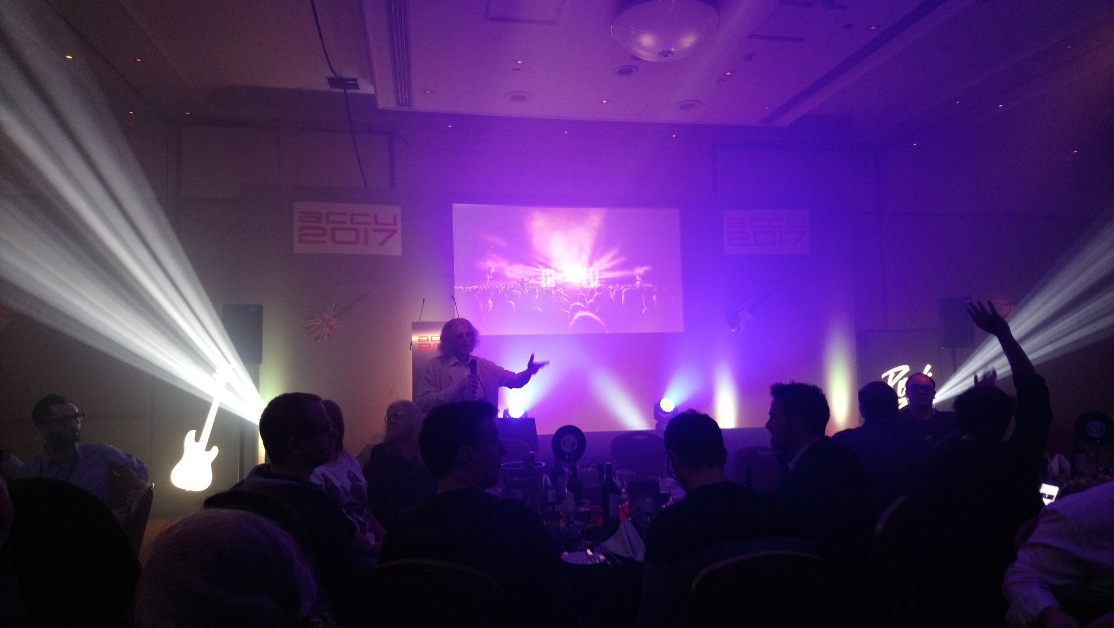
Conference Dinner
Image by Austin Bingham
Image by Neil Horlock

Slide 13
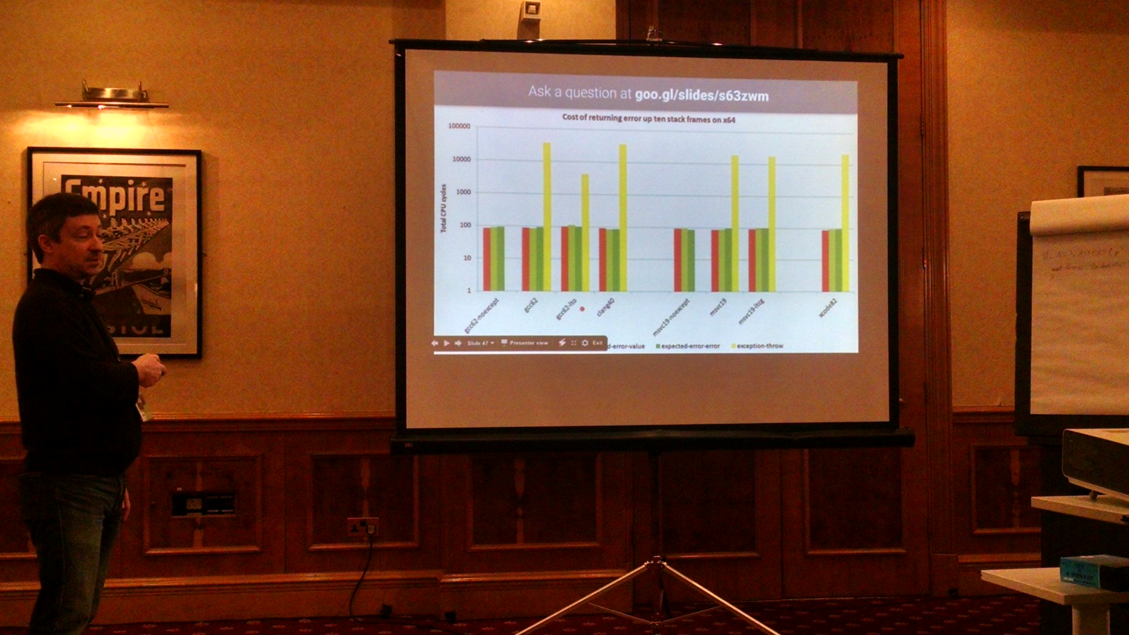
Conference Highlights 4th day
Niall Douglas: Mongrel Monads, Dirty, Dirty, Dirty
Why one should favor expected<T,E> instead of error code and exceptions
Vittorio Romeo: Implementing variant visitation using lambdas
Odin Holmes: Modern C++ Design reloaded
Based on Alexandrescu‘s classic he revisited different techniques and showed how to achieve today more with simpler code
Image by Jakie Kay

Slide 14
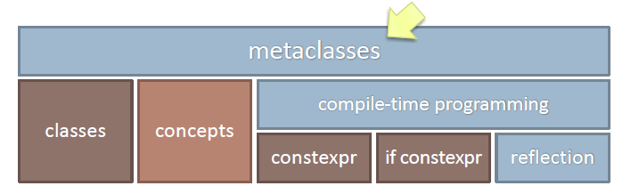
Closing Keynote by Herb Sutter
He spoke about a proposal to introduce Meta Classes into C++. Andrew Sutton and he are currently working on it
First time mentioning in the public at ACCU. Therefore video publishing will be delayed until next standard meeting
Based on the constexpr, if constexp, reflection

Slide 15
Closing Keynote by Herb Sutter
class Shape {
public:
virtual int area() const = 0;
virtual void scale_by( double factor) = 0;
// …
~virtual Shape() noexcept {}
};
interface Shape {
int area() const;
void scale_by(double factor)
// …
};

Slide 16
Meta Classes for C++
$class interface{
~interface() noexcept{ }
constexpr{
compiler.require($interface.variables().empty(),
"interfaces may not contain data members");
for (auto f : $interface.functions()) {
compiler.require(!f.is_copy() && !f.is_move(),
"interfaces may not copy or move; consider a virtual clone()");
if (!f.has_access())
f.make_public();
compiler.require(f.is_public(), "interface functions must be public");
f.make_pure_virtual();
}
}

Slide 17
Meta Classes: Qt Example
class MyClass: public QObject{
Q_OBJECT
public:
MyClass( QObject* parent = 0 );
Q_PROPERTY(int value READ get_value
WRITE set_value)
int get_value() const { return value; }
void set_value(int v) { value = v; }
private:
int value;
signals:
void mySignal();
public slots:
void mySlot();
};
QClass MyClass {
property<int> value { }; // default
signal mySignal();
slot mySlot();
};

Slide 18
More on Meta
Fun with Reflection in C++ by Jakie Kay
(https://isocpp.org/blog/2017/05/fun-with-reflection-in-cpp-jakie-kay)
Online Compiler of Herb Sutter‘s and Andrew Sutton‘s work
(https://cppx.godbolt.org/)

